Slide 1
Develop The Energy production model by enhancing the plant performance and Independent Features
Final Project Presentation
GROUP 7
Uttam Kumar Pandey
Satti. Meghana
Shaonli Samanta Roy
Dawood M D
Swejal
Under the guidance of Excelr Assignment Team

Slide 2
BUSINESS OBJECTIVES
A combined-cycle power plant comprises gas turbines, steam turbines, and heat recovery steam generators. In this type of plant, the electricity is generated by gas and steam turbines combined in one cycle. Then, it is transferred from one turbine to another.
A model was developed to represent the energy generated as a function of exhaust vacuum and ambient variables, and this model was utilized to enhance the plant's performance.

Slide 3
SUMMARY OF DATASET
This is a project where the variable to be predicted is energy production.
The data file contains 9568 observations with five variables collected from a combined cycle power plant over six years when the power plant was set to work with a full load.
The variables, or features, are the following:
temperature, in degrees Celsius.
exhaust_vacuum, in cm Hg.
amb_pressure, in milli bar. (Ambient pressure)
r_humidity, in percentage. (Relative humidity)
energy_production, in MW, net hourly electrical energy output.

Slide 4
COURSE WORK-TIMELINE
WEEKLY -MILESTONES | DURATION | Presentation
Kick off and Business Objective discussion | 1 day | 12-APR-2024 4 PM- 6PM
EDA 1 | ½ week | 19-APR-2024 4:15 – 5:15pm
Model Building | ½ week | 24-APR-2024 4:15 – 5:15pm
Model Evaluation | 1 Week | 30-APR-2024 4:15 – 5:15pm
Deployment | 1 Week | 03-MAY-2024 2:30 PM-3:30 PM
Final presentation | 1 Week | 10-MAY-2024 3:00 – 4:00 pm

Slide 5
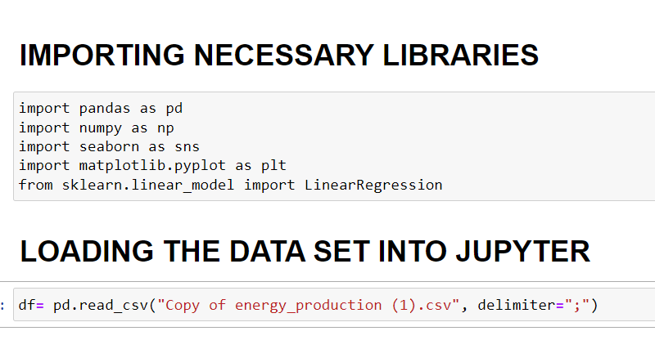
Basic Libraries and Loading of Dataset
We have Imported Basic libraries required for the dataset.
We have Loaded the dataset into Jupyter.

Slide 6
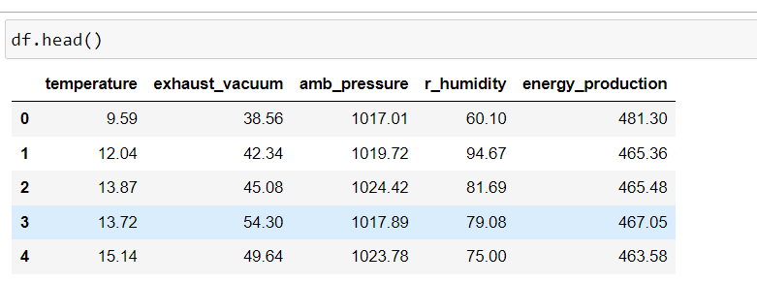
Dataset Preview
The df.head( ) gives us the preview of the dataset.
We have 4 independent variables such as Temperature, Exhaust_vacuum, Amb_pressure and R_humidity.
Similarly we have one Dependent Variable Energy_production.

Slide 7
Exploratory Data Analysis Part -1
Pythoncodes | Output functions
df.info( ) | Shows the Information of Dataset.
df.value_counts.sum( ) | Counts the total number of rows in the Data set.
df.shape | Counts the total number of rows and columns in the Data set.
df.columns | Show the details about Column names.
df.isnull( ).sum( ) | Show the Total Null Entries in the Dataset

Slide 8
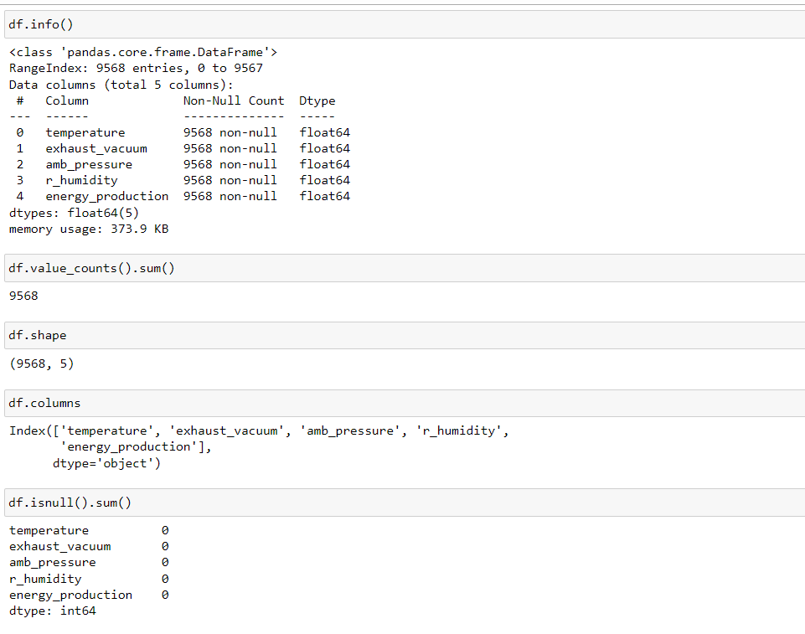
Descriptive Dataset Python Codes

Slide 9
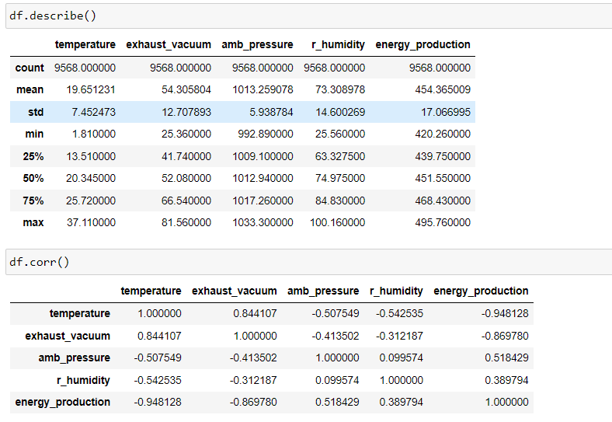
Description And Correlation
Description of the Feature columns and Correlation between the columns

Slide 10
Visualization of Distinct Independent Variables in the prevailing dataset
Independent Features | Graphs
Temperature | Bar Graph & Boxplot
Exhaust_vacuum | Bar Graph & Boxplot
R-humidity | Bar Graph & Boxplot
Amb_pressure | Bar Graph & Boxplot
Dependent Feature | Graphs
Energy Production | Bar Graph & Boxplot

Slide 11
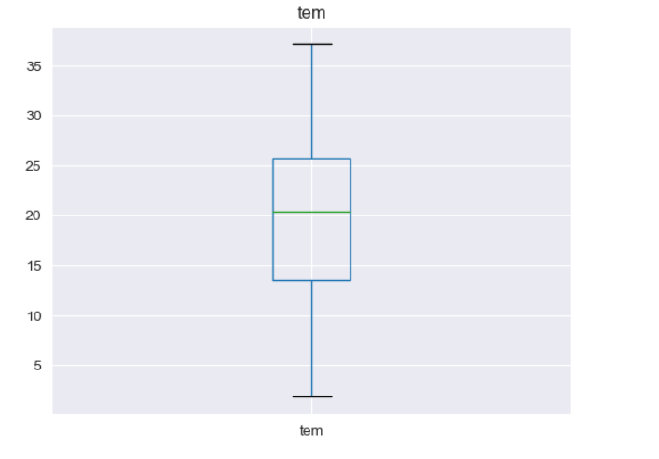
Temperature profile
The bar graph of temperature profile show distribution of temperature values vs. frequency.
The Box plot shows there are no outliers present in the temperature variable.
The Mean and Median are almost at the centre of the Boxplot.

Slide 12
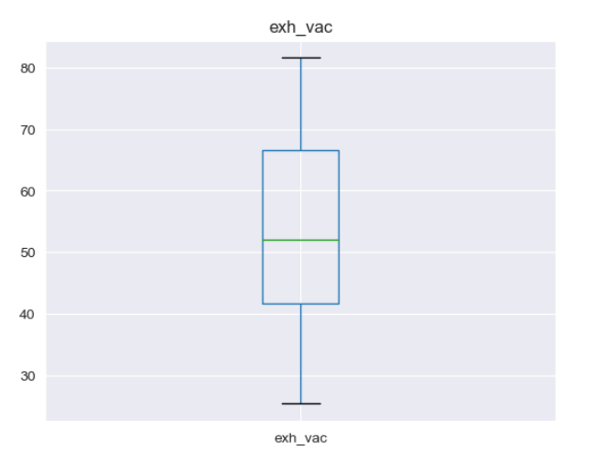
Exhaust Vacuum Profile
The bar graph of Exhaust Vacuum profile show distribution of the exhaust vacuum values vs. frequency.
The Box plot shows there are no outliers present in the Exhaust vacuum variable.
The Mean and Median are almost at the centre of the Boxplot.

Slide 13
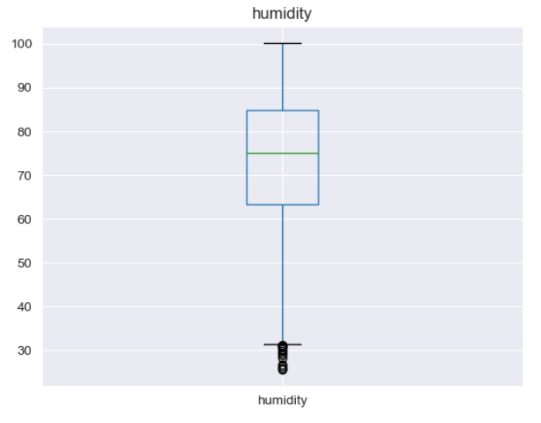
Relative Humidity Profile
The bar graph of Relative Humidity profile show distribution of the humidity values vs. frequency.
The Box plot shows there are no outliers present in the Relative humidity variable.
The Mean and Median are Shifted marginally towards the upper quartile of the Boxplot.
The relatively some outliers are present at the lower quartile of the Relative humidity variable.

Slide 14
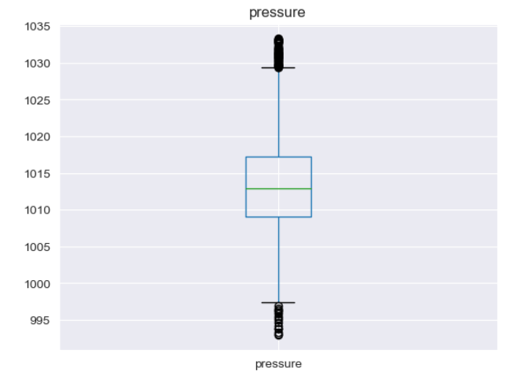
Ambient Pressure Profile
The bar graph of Ambient pressure profile show distribution of the pressure values vs. frequency.
The Box plot shows there are no outliers present in the Ambient Pressure variable.
The data have mean and mode at the center of the boxplot.
The relatively some outliers are present at the lower quartile and upper quartile of the Ambient pressure variable.

Slide 15
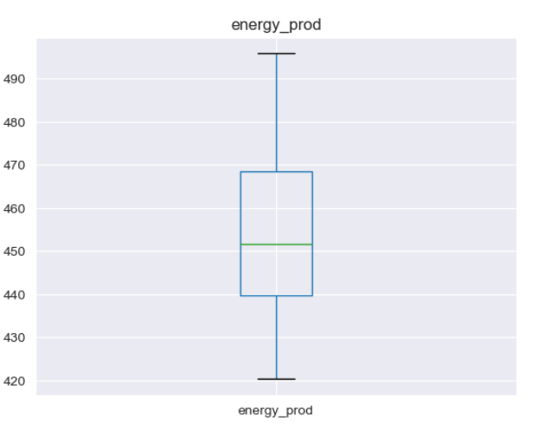
Energy Production Dependent Variable
The bar graph of Energy Production profile show distribution of energy productriuon values vs. frequency.
The Box plot shows there are no outliers present in the Energy production variable.
The Mean and Median are Shifted marginally towards the lower quartile of the Boxplot.
The relatively some outliers are present at the lower quartile of the Energy production variable.

Slide 16
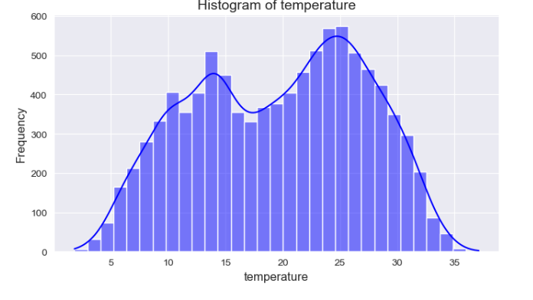
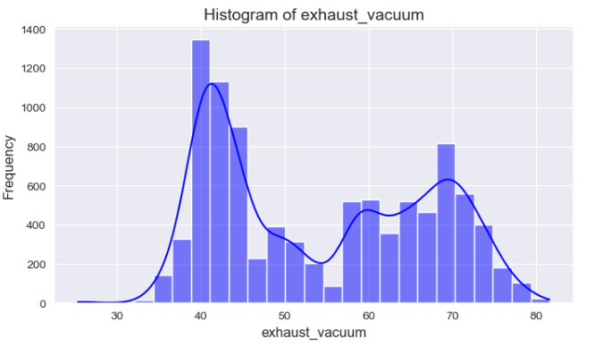
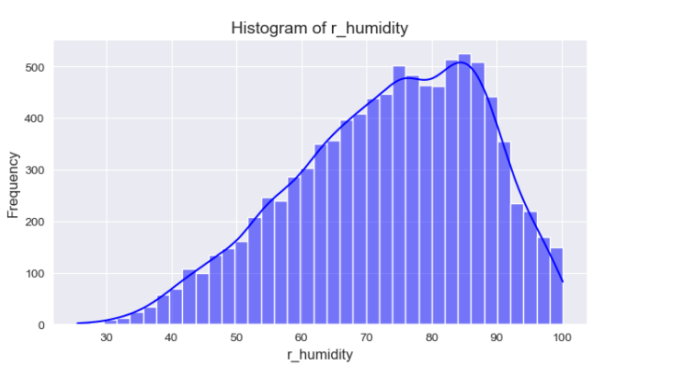
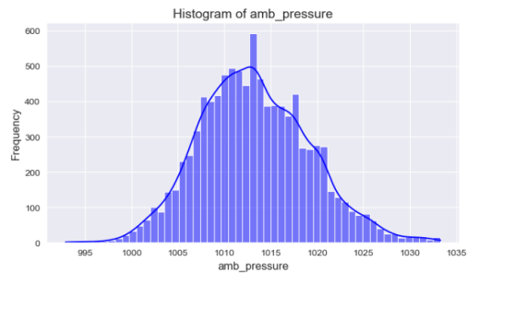
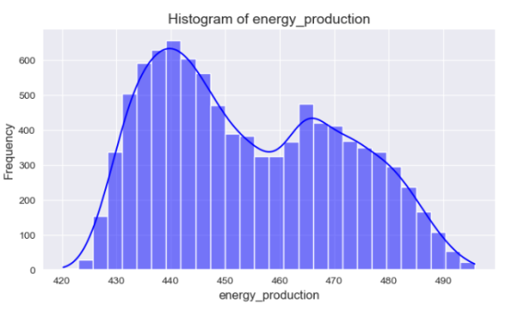
Histogram of independent and dependent variables

Slide 17
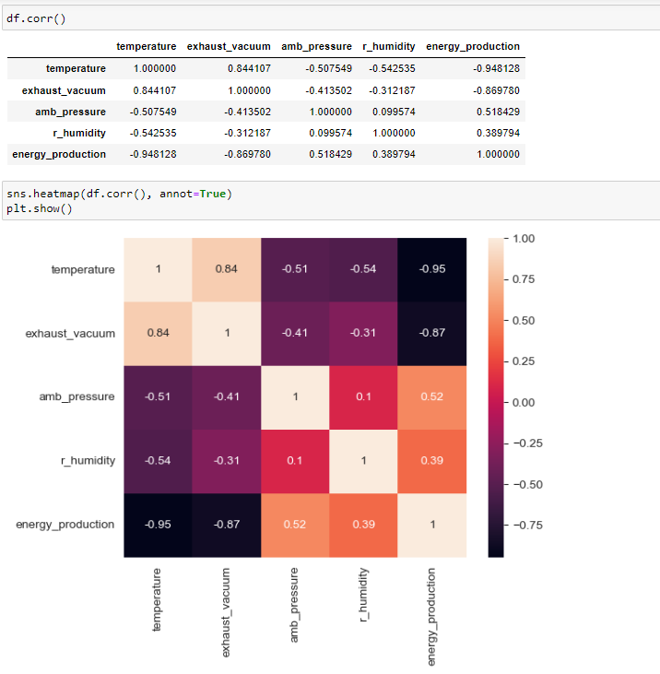
THE Correlation and Heat map of the dataset
These python commands show the necessary correlation in the data set.
The table shows the realative correlation between the features in the dataset.
The heat map derived from the dataset also correlate the all features independent and dependent variables present in the dataset.

Slide 18
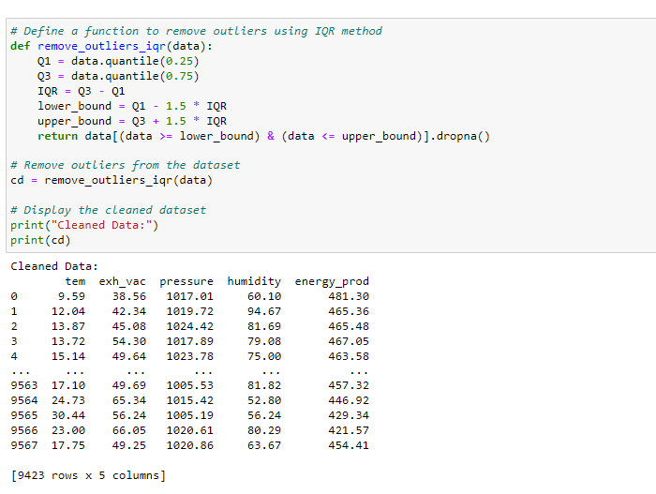
Exploratory Data Analysis Part -2
The following code represent the removal of necessary outliers present in the dataset.
We have applied IQR approach for the removal of the necessary outliers.
The dataset after the removal of outliers retains the 9423 rows and 5 columns from the dataset.

Slide 19
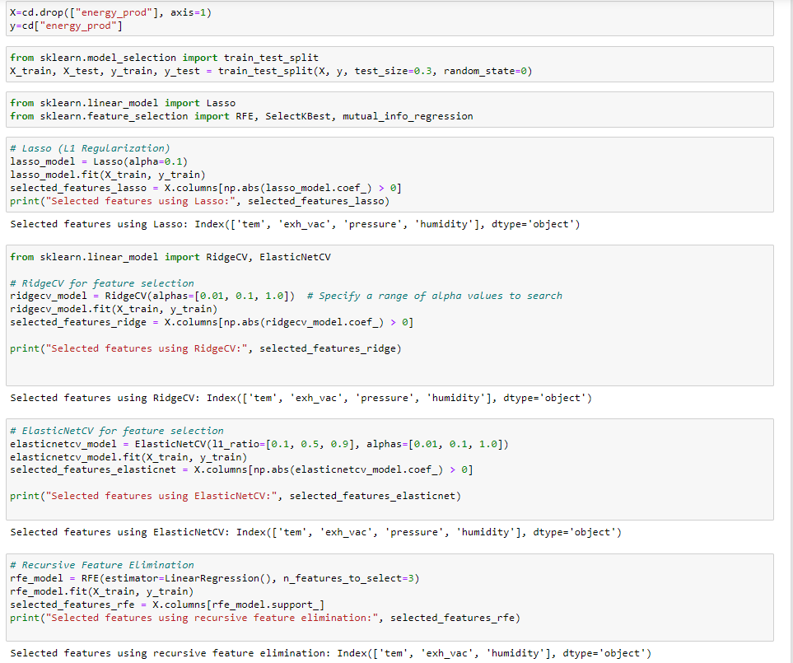
Feature Selection
Here we have applied train test split method for dividing the dataset into training(70%) and testing (30%).
The Following feature engineering approaches have been implemented as follows:
Lasso , Rigde , Elasticnet_cv and Recursive feature Eliminatination(RFE).

Slide 20
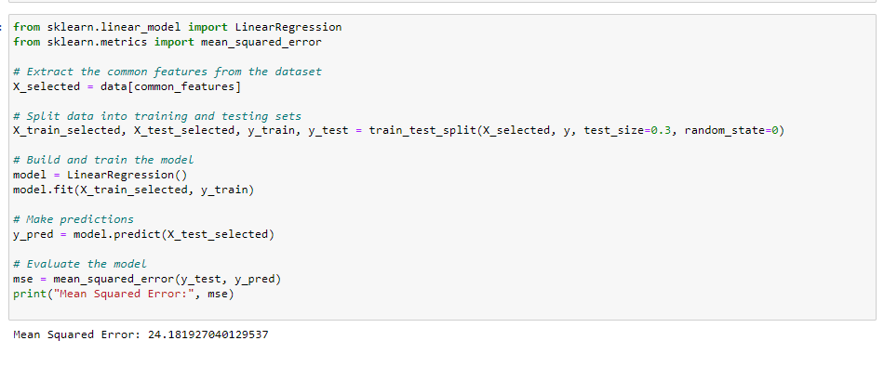
Model Building (Linear Regression)
We have checked mean squared error with Linear regression.

Slide 21
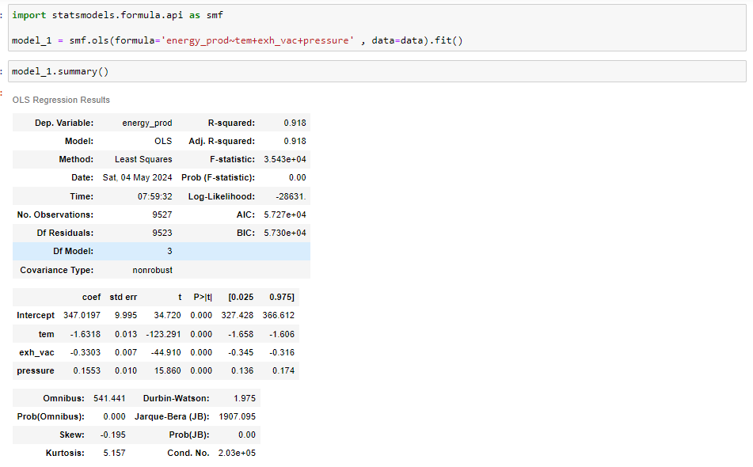
Model Building (OLS Method)

Slide 22
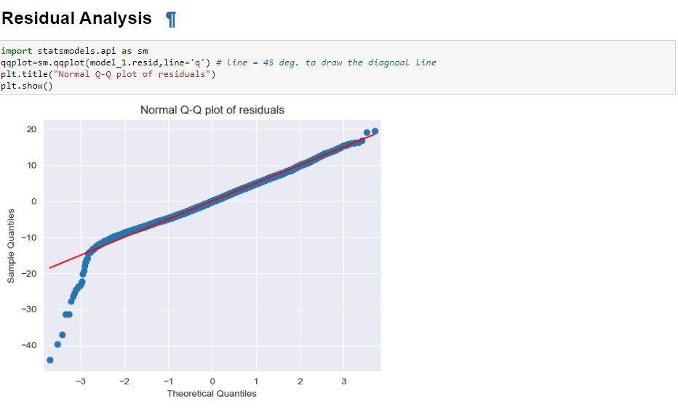
Visualizations
This residual plot reveals normal distribution of data.

Slide 23
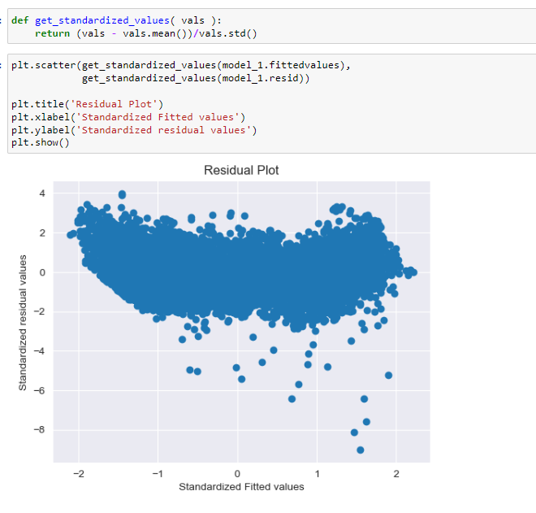
Visualization - 2
This residual plot show the plot of standardized residual vs. standardized fitted values.
This Visualization is applied after the important feature selection and Elimination of unnecessary features.

Slide 24
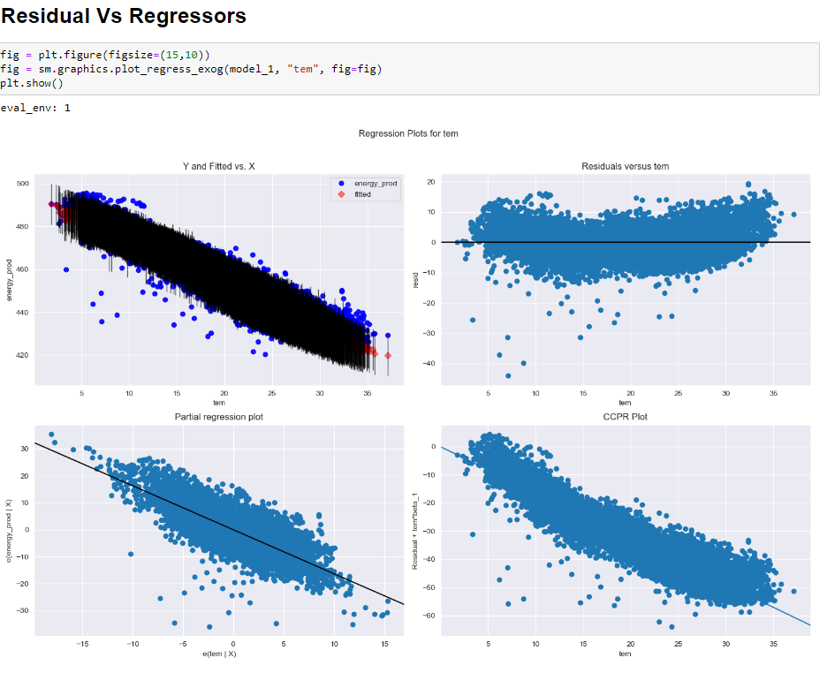
Visualization -3
This the residual vs. regressors for the Temperature profile.
The Y vs.X fitted represent how temperature is affecting the dependent variable.
The residual vs. temperature graph represent how standardized data is fitted with residuals .
The other plots represent temperature vs. Energy production.

Slide 25
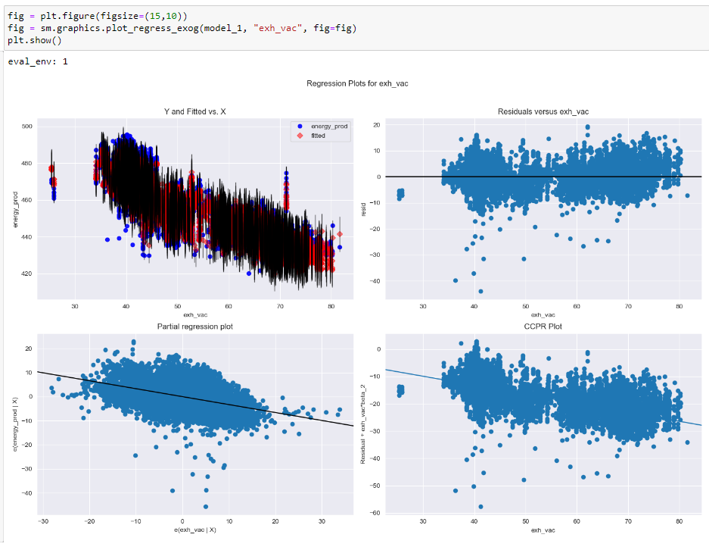
Visualization - 4
This the residual vs. regressors for the Temperature profile.
The Y vs.X fitted represent how exhaust vacuum is affecting the dependent variable.
The residual vs. exhaust vacuum plot represent how standardized data is fitted with residuals .
The other plots represent exhaust vacuum vs. Energy production.

Slide 26
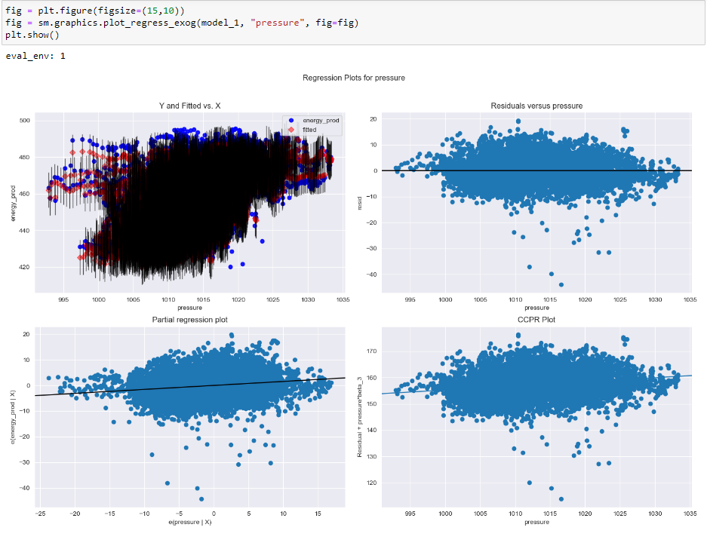
Visualization -4
This the residual vs. regressors for the Pressure profile.
The Y vs.X fitted represent how pressure is affecting the dependent variable.
The residual vs. temperature graph represent how standardized data is fitted with residuals .
The other plots represent pressure vs. Energy production.

Slide 27
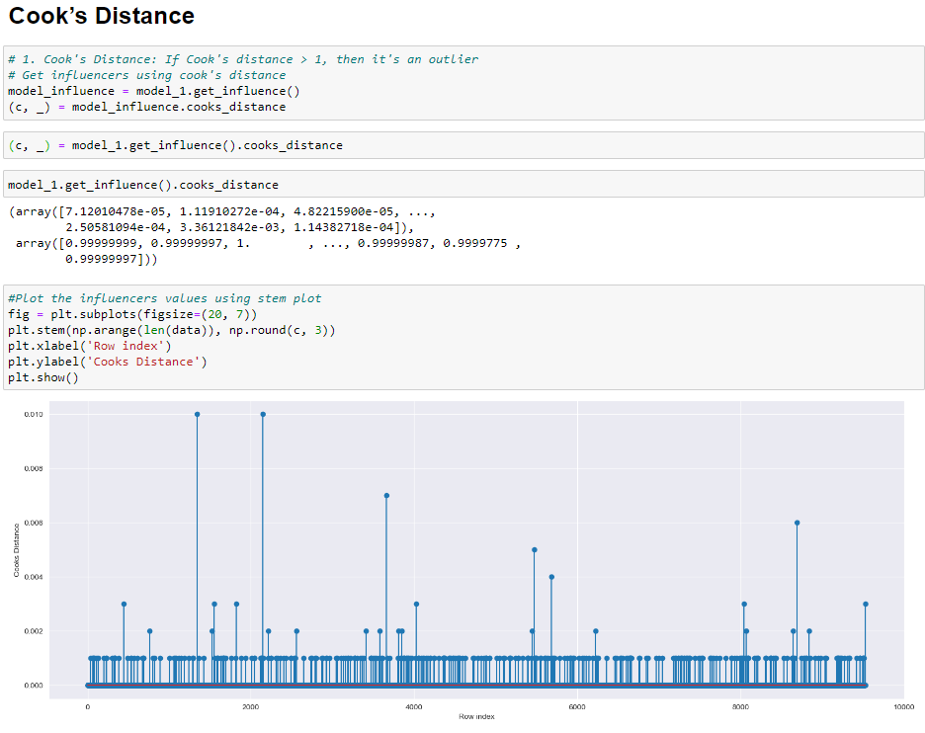
Visulization-6

Slide 28
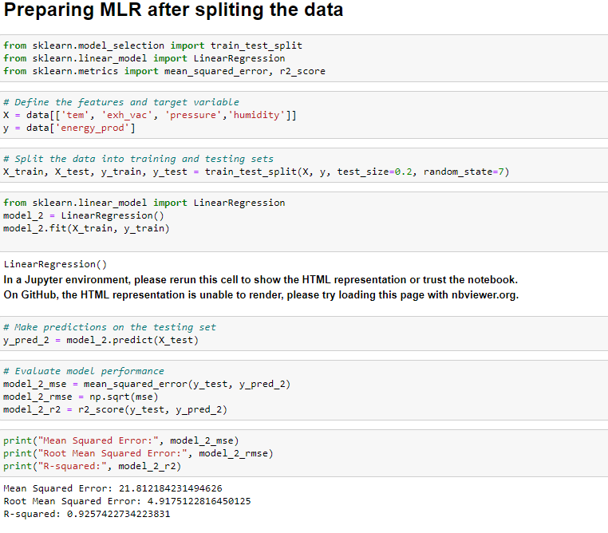
Model Building-1
The Final model building part we have applied various different method for checking and improving the accuracy .
The following approaches involved in the final part of model building are Linear Regression ,OLS, PCA, XGBoost, Decesion tree, Random forest, Polynomial Regression, Support vector machines.

Slide 29
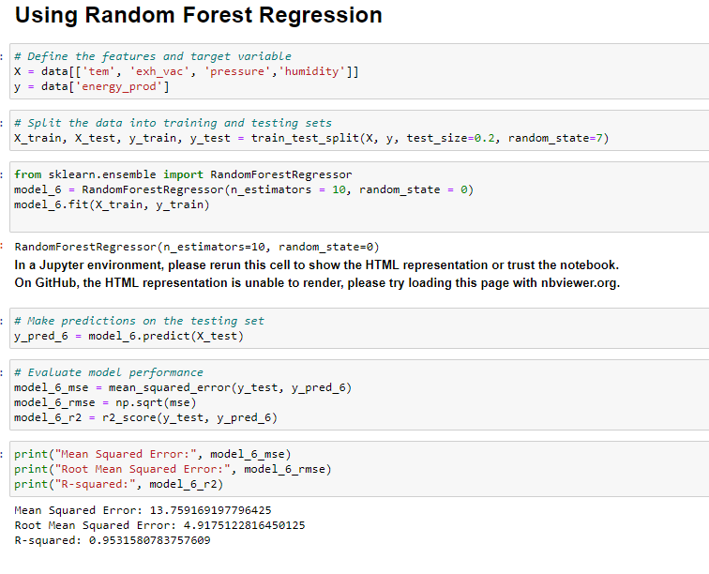
Model building-2

Slide 30
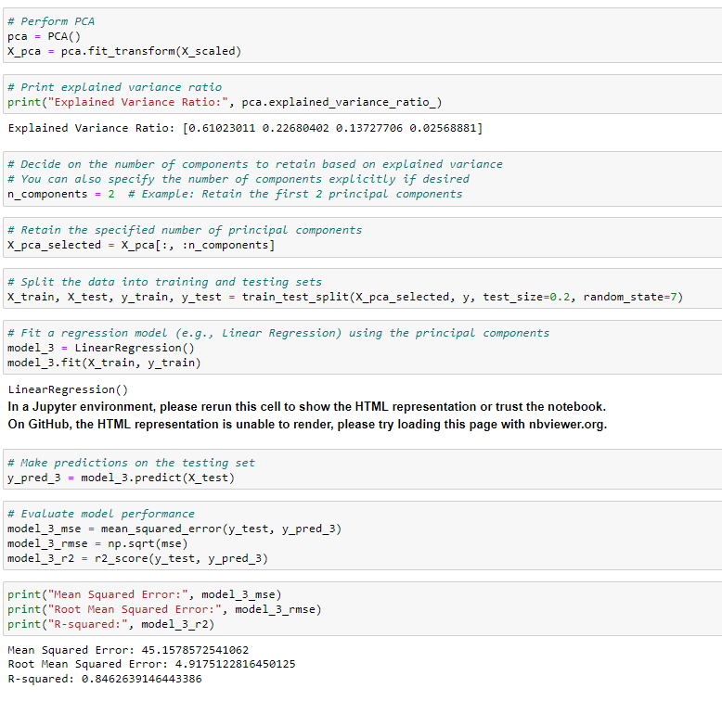
Model building_-3

Slide 31
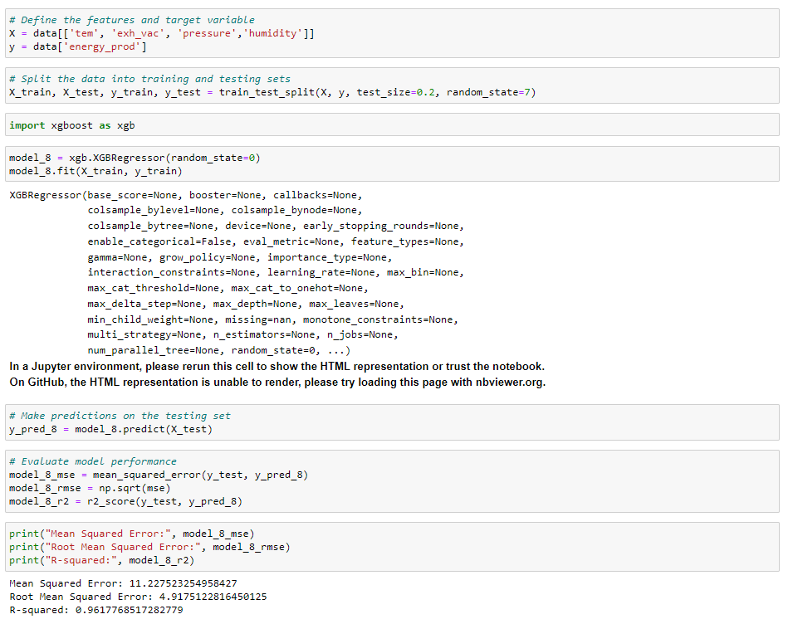
Model building-4

Slide 32
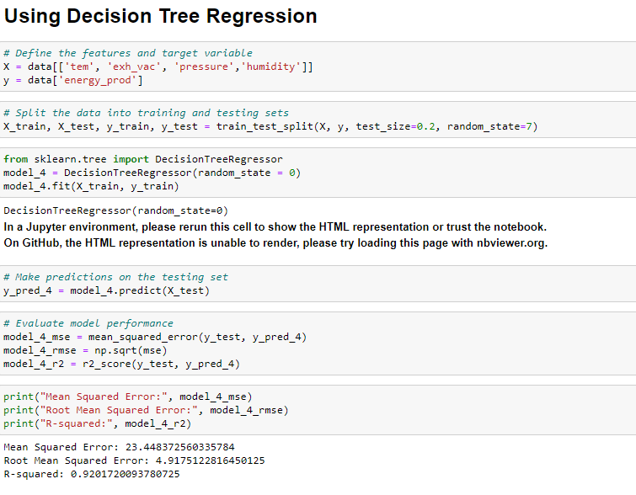
Model building_-3

Slide 33
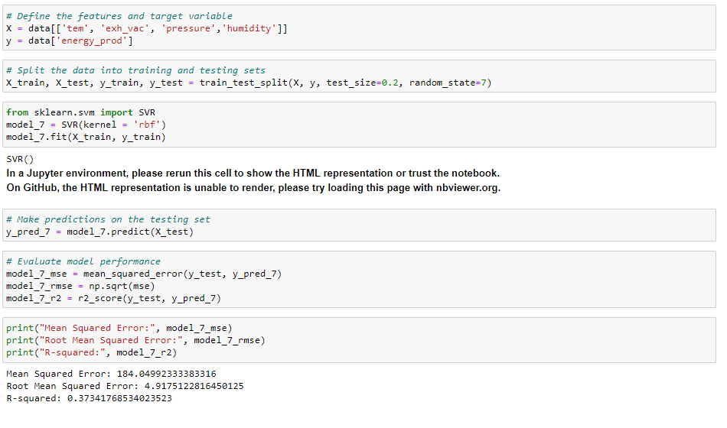
Model building_-3

Slide 34
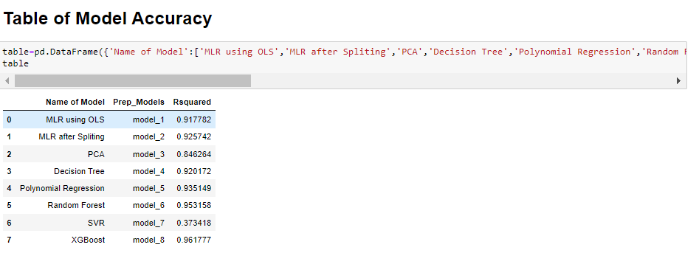
Model building_-3
This dataframe represent the model Accuracies of different approaches Implemented for this dataset.
Here for the support vector machine we applied it on the regular data without normalization of the features in the dataset

Slide 35
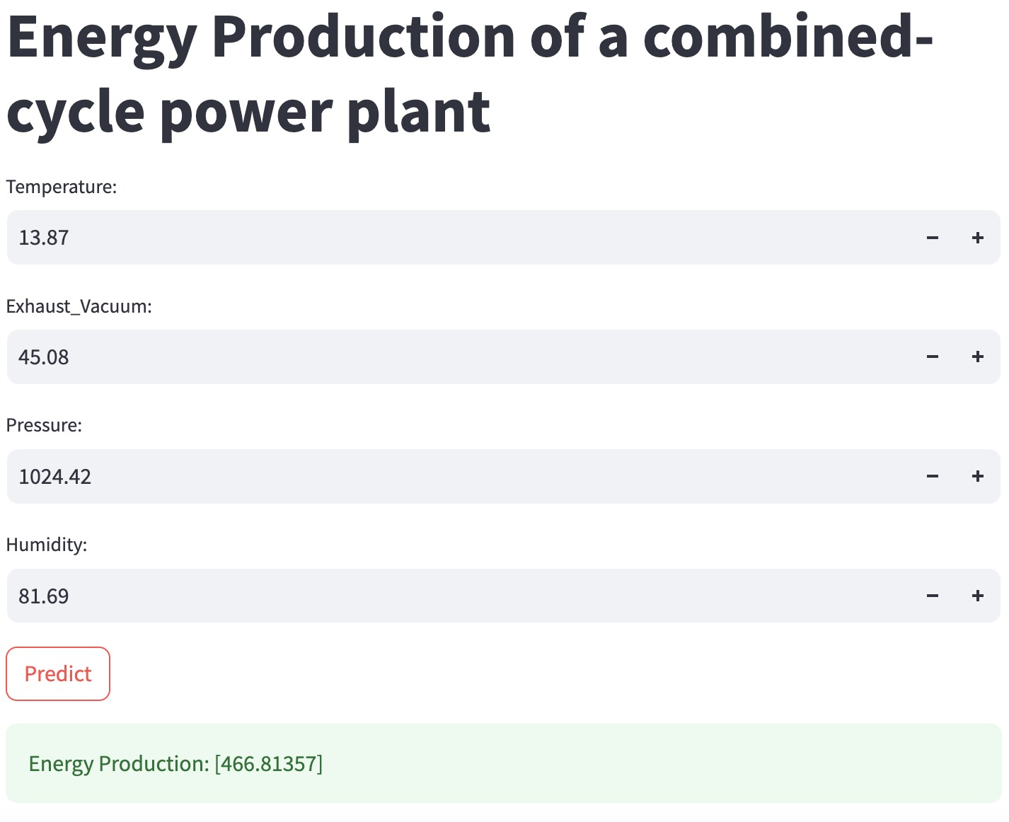
Final Deployment Actual Vs. predicted

Slide 36
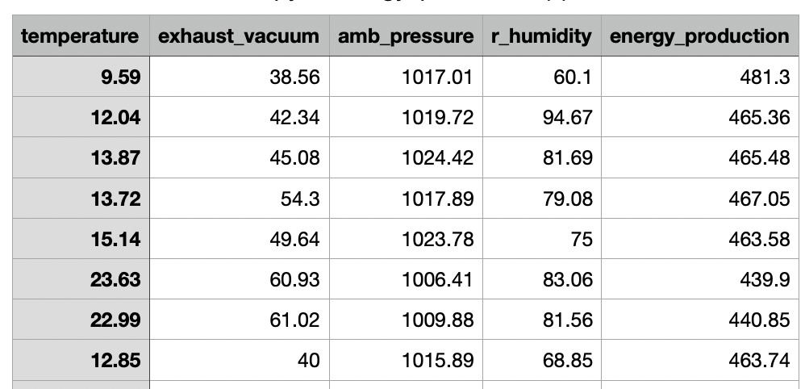
Actual value

Slide 37
Thank you

